Slide 1


Automating Chaos Engineering
with the Chaos Toolkit
Proactive Reliability Validation
Sylvain Hellegouarch • ChaosIQ CTO • Lead Developer of the Chaos Toolkit • KubeCon 2018

Slide 2
A reminder

Slide 3
Chaos Engineering starts with the rather high complexity of “knowing” our systems end to end.
It is one tool/practice/discipline which collects data to remain knowledgeable.
Practicing edge cases in a controlled manner is at the heart of Chaos Engineering

Slide 4
A Chaos Engineer mindset?
The Chaos Engineer is not a rockstar but loves supporting the team.

Slide 5
Be open minded
Practice the art of experience without prejudice.

Slide 6
Nurture empathy
Don’t blame or be snarky. Assertive but not arrogant.

Slide 7
Love an experimental approach
Don’t be scared of not knowing the outcome. It’s the fun of the game.

Slide 8
The Chaos Engineering flow

Slide 9
The Chaos Engineering flow
1. or 3. System not as it should
Steady State Hypothesis
1. System looks normal
2. Did we deviate?
Weakness discovered?
Apply method
I wish I were better at diagrams. Screenshots allowed, though :D

Slide 10
Steady state
The steady state refers to the normality in your systems.

Slide 11
For instance “Customers spend $X at 8am on average”
It is your baseline. It comes from objective observations.

Slide 12
Let’s hold back a minute
Forming a hypothesis is not always straightforward.

Slide 13
Usually, you first ask questions based on intuition.

Slide 14
Even before that, you should observe the system to collect data leading you to good questions.

Slide 15
Hypothesis

Slide 16
The hypothesis makes a statement that should be proved or disproved
Usually to detect weaknesses, but can also be used to predict an outcome.

Slide 17
For instance “Reducing by half our payment service instances does not decrease the average spending.”

Slide 18
The hypothesis doesn’t have to be business oriented but decide which metrics are really critical for you.

Slide 19
Experimental method

Slide 20
Things we vary in the system to prove/disprove the hypothesis.
But should also probe the system for relevant data to support the analysis.

Slide 21
For instance “Scale down the payment service by half and query Prometheus for the number of payment and their amount during that period.”

Slide 22
Don’t vary too many things or analysis will be fruitless.

Slide 23
In summary

Slide 24
A Chaos Engineer demonstrates great empathy for users, teams and the system.

Slide 25
By observing the system, the Chaos Engineer asks questions leading to hypothesis and an experiment.

Slide 26
A chaos experiment starts with a steady-state hypothesis.

Slide 27
A chaos experiment varies conditions in the system while probing for relevant data.

Slide 28
Did the system deviate? We proved our hypothesis and can start learning.

Slide 29


Slide 30
implements the flow of the experiment we just described.

Slide 31
is an open source tool, born in September 2017.

Slide 32
gathers a small, nicely growing, community with contributions from its members.

Slide 33
is implemented in Python 3.5+ with a functional approach.

Slide 34
Core objectives

Slide 35
Be the entry points for Chaos Engineering experiments.

Slide 36
Simplicity is the key for durability in a software.

Slide 37
Interface with platforms and systems natively.
Prefer extending over re-writing.

Slide 38
Be declarative.

Slide 39
Automation first class citizen.

Slide 40
Be a friendly project community :)

Slide 41
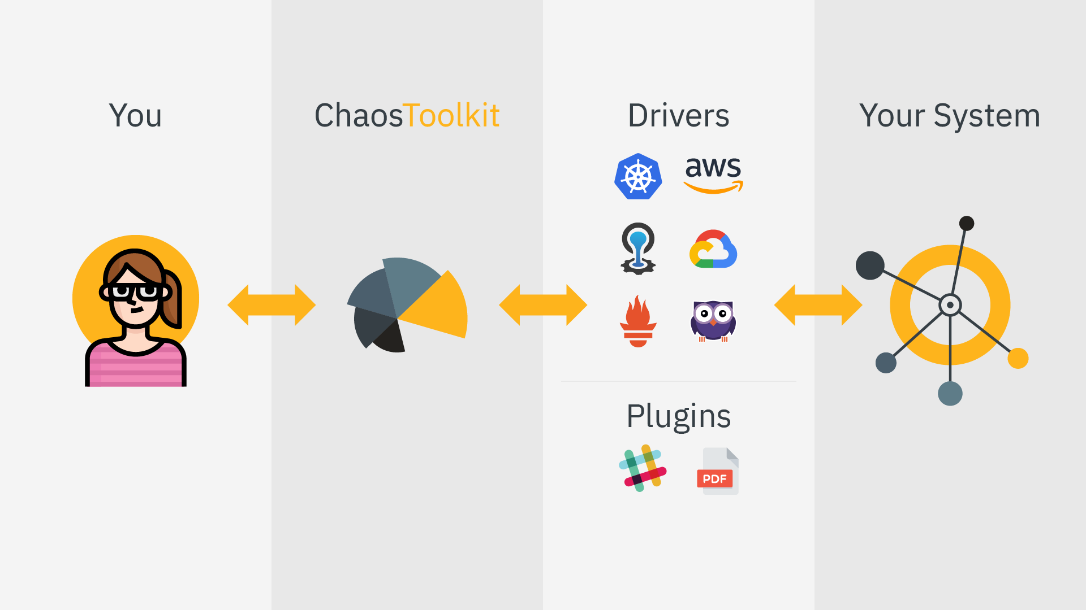

Slide 42

General architecture
Kubernetes driver
Kube API
AWS driver
AWS API
Experiment
Chaos Toolkit CLI + Core
GCE API
ZE System
GCE driver
Azure driver
Azure API
Prometheus driver
Prom API
Slack plugin

Slide 43
Experiment

Slide 44
Open API for a declarative description of the experiment end-to-end.
Specified at http://chaostoolkit.org/reference/api/experiment
Can be described in JSON and YAML.

Slide 45
Drivers

Slide 46
Drivers are merely extensions that know how to talk to a specific system through its API.

Slide 47
Drivers can be in Python or even simple processes executed by the toolkit.

Slide 48
Drivers don’t try to be too clever, but offer the right level of operations you need to shake and probe your system.

Slide 49
Existing drivers
Kubernetes GCE AWS Azure
Humio Cloud Foundry Prometheus

Slide 50
Plugins

Slide 51
Plugins are extensions that add functionalities to the toolkit itself.
Reporting
Notifications (Slack…)

Slide 52
Demo(s)

Slide 53
What’s next for the Chaos Toolkit?

Slide 54
Kubernetes Job/CRD for scheduling
Newer Documentation
Drivers in other languages (Go, Rust…)
More on discoverable experiments
A 1.0 in 2018

Slide 55
Any questions?
@lawouach

